Slide 1
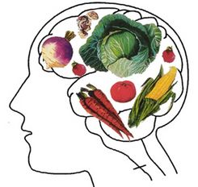
Nursing Care of the Client with Malnutrition: Week 3
Candace Walker - Winter 2019
Revised from K. McLaughlin

Slide 2
Concepts
Transition and change
Collaboration
Accountability

Slide 3
Learning Outcomes
Identify the related concepts of transition and change, collaboration, and accountability in relation to malnutrition
Understand the nursing care required to care for a malnourished client

Slide 4
Definition
“Malnutrition is a deficit, excess, or imbalance of the essential components of a balanced diet” (Soeters & Schols, 2009)
Can refer to alterations in:
May also be described as under or over nutrition

Slide 5
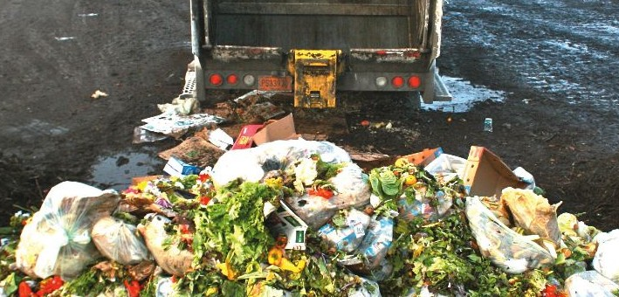
Undernutrition
Developing countries:
Inadequate food sources
Socioeconomics
Canada:
Key SDOH
Lone-parent families
Social assistance
Aboriginal people living off reserve
Hospital and LTC
37-55%

Slide 6
Protein-Calorie Malnutrition (PCM)
Most common
Primary, Secondary, and Combined (most ill, malnourished patients)
Primary:

Slide 7
Protein-Calorie Malnutrition (PCM)
Secondary:
AKA “disease-related malnutrition”
Alteration or defect in:
Ingestion
Digestion
Absorption
Metabolism
Causes:

Slide 8
Etiology
Development of malnutrition

Slide 9
Etiology - socioeconomics
Socioeconomics
Food Security: “Physical and economic access to sufficient, safe, and nutritious food that meets food preferences and dietary needs for an active and healthy life” (Cook et al., 2008)
Food insecurity

Slide 10
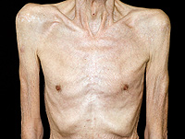
Etiology – physical illness
Physical Illnesses
Anorexia is “a loss of normal appetite and may occur as a result of physical or mental illness”
Cachexia refers to “a wasting syndrome that causes weakness and loss of weight, fat, and muscle”
Malabsorption Syndrome is “the impaired absorption of nutrients from the GI tract”

Slide 11
Etiology-incomplete diets
Incomplete Diets
Vitamin deficiencies
Canada’s food guide
ETOH/drug use, chronically ill, poor diets
Fad diets, “poorly planned” vegetarians
Vitamin imbalances affect NEURO
Children – CNS
Adults - PNS

Slide 12
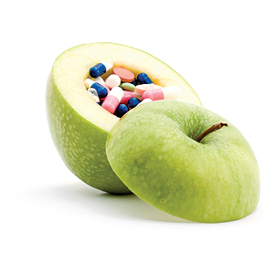
Etiology – food-drug interactions
Food-Drug Interactions

Slide 13
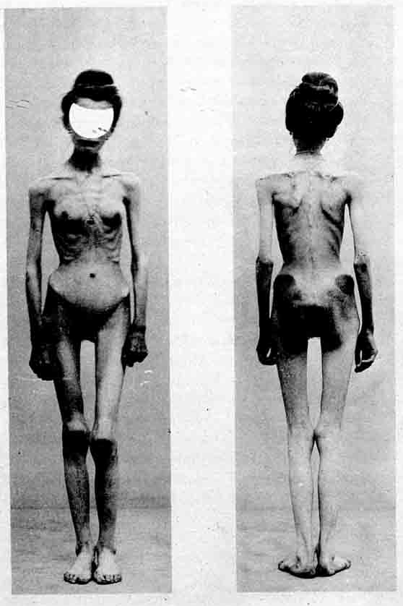
Etiology-psychological illness
Eating Disorders

Slide 14
Malnutrition in the elderly
Increased risk factors

Slide 15
Clinical Manifestations
Skin:
Dry, scaly
Brittle nails
Rashes
Hair loss
Mouth:
Crusting and ulceration
Changes in tongue
Tooth decay
Muscles:
Decreased mass
Weakness
CNS:
Cognition – confusion, irritability, lethargy

Slide 16
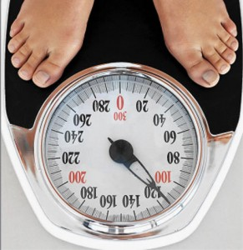
Assessment
Height
Weight
Diet history
Medical history
Routine lab data
Albumin/Prealbumin
Transferrin
CRP
Electrolytes
RBC and Hgb
Lymphocyte count
LFTs

Slide 17
Assessment
Tools:
Malnutrition Screening Tool (MST)
24 hour Recall
Food Frequency Questionnaire
Food Diary
Direct Observation

Slide 18
Diagnosis
Imbalanced nutrition: less than body requirements related to decreased access to or ingestion, digestion, or absorption of food or to anorexia
Self-care deficit (feeding) related to decreased strength and endurance, fatigue, and apathy
Constipation or diarrhea related to poor eating patterns, immobility, or medication effects
Deficient fluid volume related to factors affecting access to or absorption of fluids
Risk for impaired skin integrity related to poor nutritional state
Nonadherence related to alteration in perception, lack of motivation, or incompatibility of regimen with lifestyle or resources
Activity intolerance related to weakness, fatigue, and inadequate caloric intake or iron stores

Slide 19
Planning
Achieve weight gain
Consume a specified number of calories per day (with a diet individualized to the patient)
Have no adverse consequences related to malnutrition or nutrition therapies

Slide 20
Implementation
Health Promotion
Ambulatory and Home Care
Acute Intervention

Slide 21
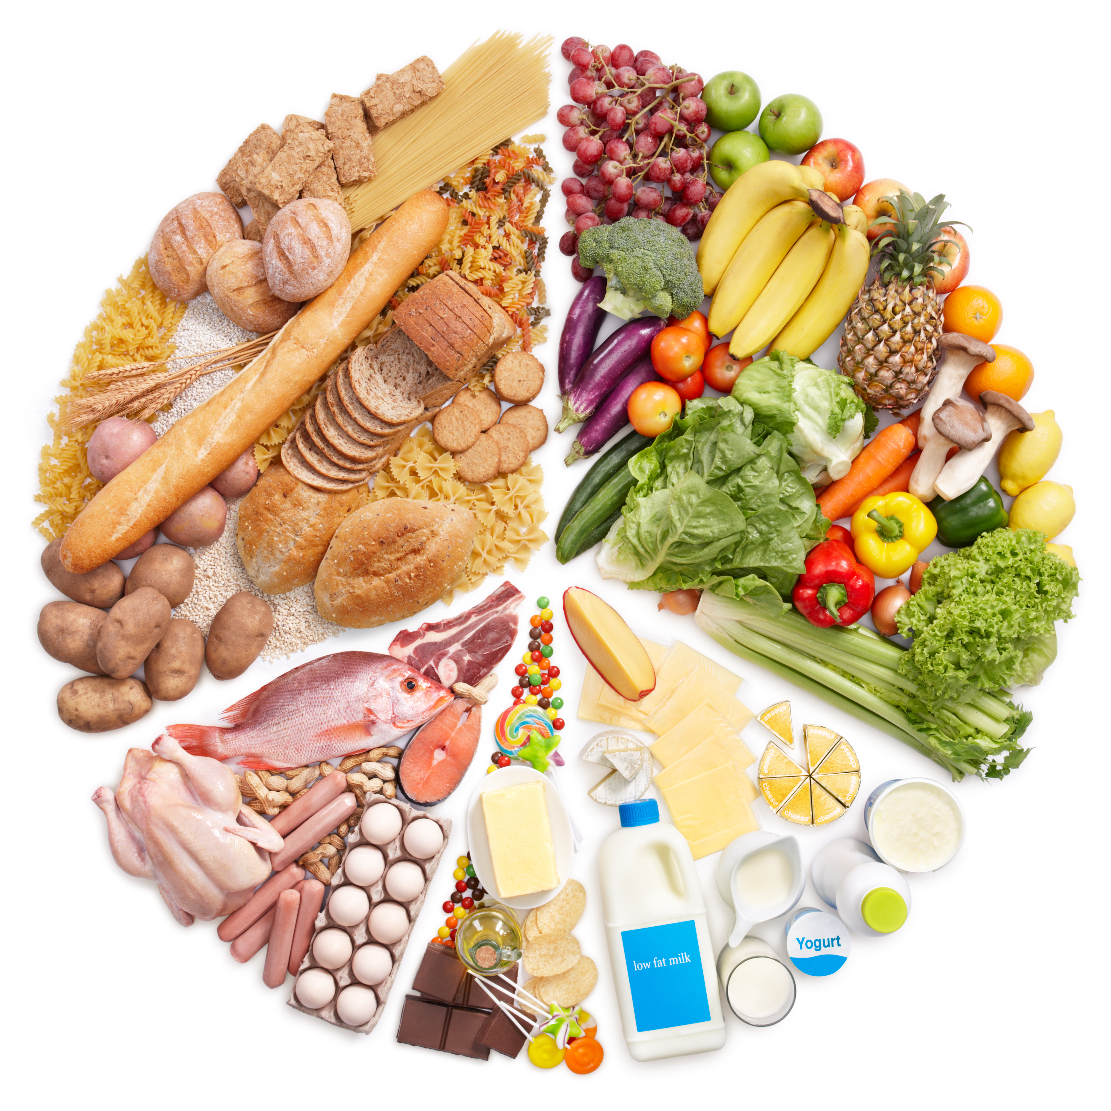
Evaluation
The patient will achieve and maintain optimal
body weight
The patient will consume a well-balanced diet
The patient will experience no adverse outcomes
related to malnutrition

