Slide 1
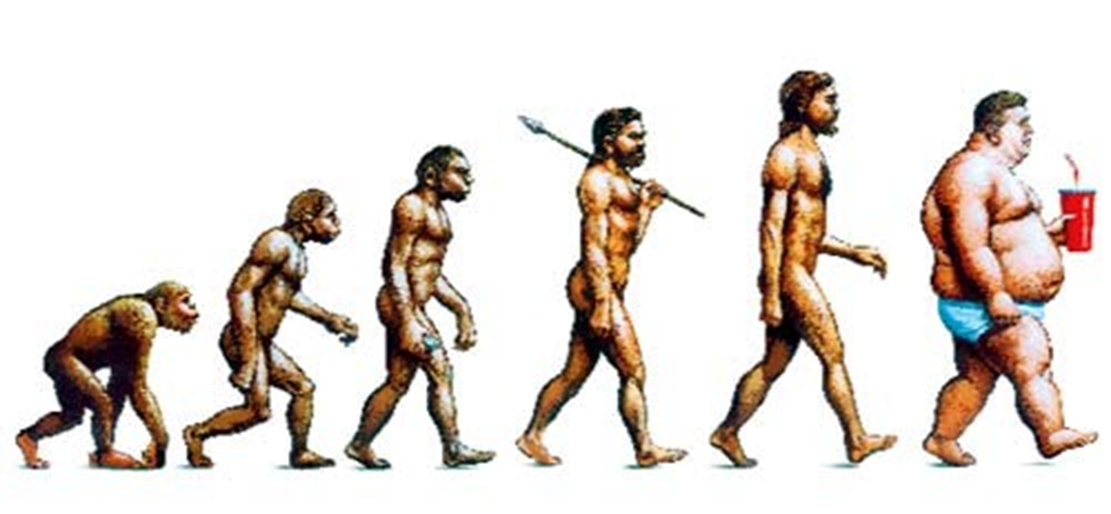
Care of the Bariatric Patient
Week 4
By A. Sullivan and Candace Walker revised by P. MacNeill winter 2019

Slide 2

Concepts
- Stigma in health care
- Guilt
- Shame
- Stress
- Spirituality
- Caring

Slide 3
Learning Outcomes
The learner will be able to:
-Examine their own beliefs around obesity
-Describe the health challenges that bariatric clients may experience
-Describe specific challenges associated with the care of the bariatric client
-Discuss nursing interventions and strategies to decrease the challenges associated with nursing care

Slide 4
Definition
“Overweight and obesity are defined as abnormal or excessive fat accumulation that presents a risk to health.”
“Overweight and obesity are major risk factors for a number of chronic diseases, including diabetes, cardiovascular diseases and cancer.”
-World Health Organization, 2018

Slide 5
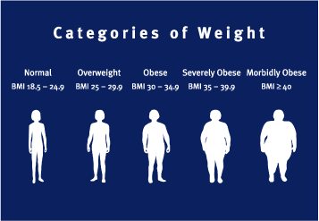

Slide 6
Waist Circumference
In addition to BMI, it is suggested to measure waist circumference in those who are overweight or obese to assess abdominal obesity
Significant increased cardiometabolic risk:
Men > or = to 102 cm
Women > or = to 88 cm

Slide 7
Measuring Waist Circumference
http://www.heartandstroke.ca/get-healthy/healthy-weight/healthy-weight-and-waist
Notes:
Watch this video to see how the waist is measured appropriately for accurate results

Slide 10
Canadian Stats
In 1985:
Fewer than 10% of Canadians were obese in all 9 provinces
In 1990:
Only 3 provinces had fewer than 10% of people who were obese
In 1994:
-No provinces had this low of obesity rates
- Five provinces had obesity rates 15-19%
Notes:
Bray & Perreault, 2017 UptoDate

Slide 11
Stats Canada 2014
Obesity rates Canadian Men:
21.8%
Obesity rates Canadian Women:
18.7%

Slide 12
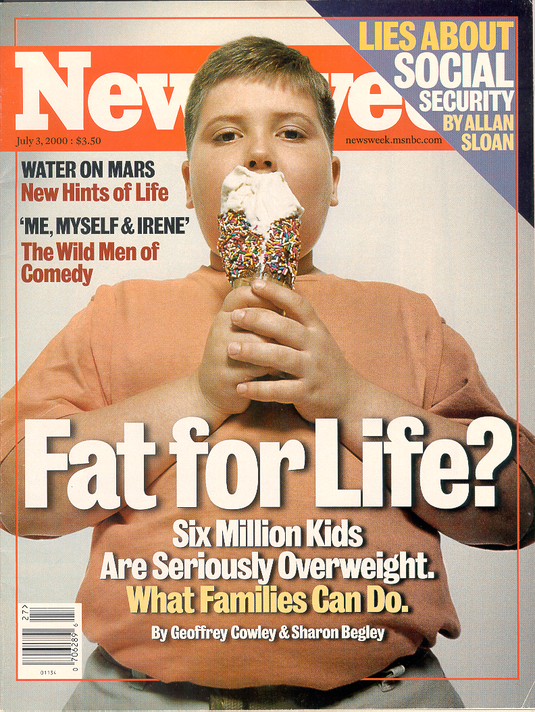
Generation XXL
Notes:
Do images like this contribute to the stigmatization of obesity?

Slide 13
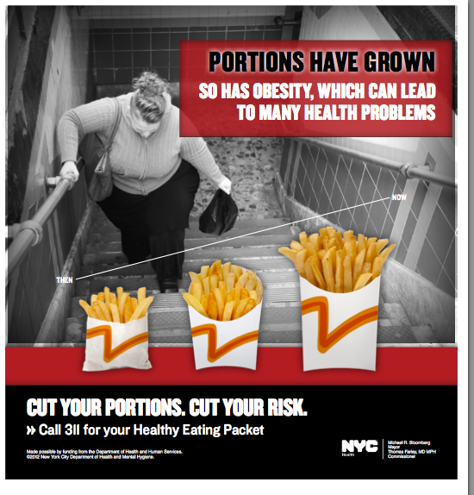

Slide 14
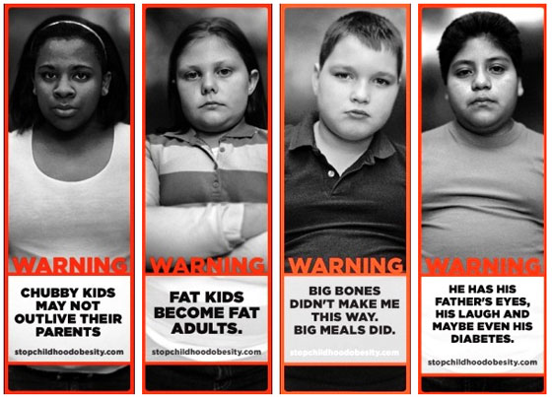

Slide 15
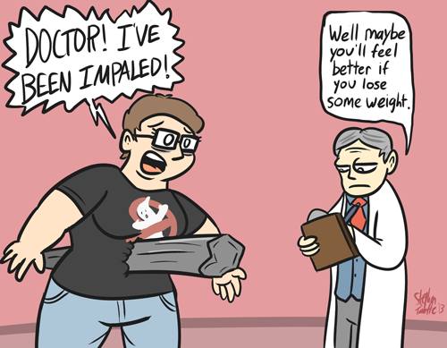

Slide 16

Personal Reflection/
Article Dialogue
When hearing the term “obese” or
“bariatric,” what images/stereotypes come to mind?
How does the health care system
stigmatize obese and bariatric clients?
How might obese and bariatric clients
respond to being stigmatized?
4) Do obese patients have an increased risk for a mental health diagnoses?
5) What can be done to change
the mind set towards obese
patients?
Notes:
Reflective activity
Post-amble…
Among health care workers, clear evidence exists for an anti-fat bias, although less than in general society
HCW can have strong negative association towards obese persons – body language and expression
Obese people may resist seeking healthcare d/t stigma, lack of mobility, and embarrassment
Receiving healthcare can be physically and emotionally trying
Controllable causes of obesity
Sedentary lifestyle
Poor nutritional habits
Non-controllable causes of obesity
Hypothyroidism
Cushings syndrome
Depression
Certain medications – steroids, some antidepressants, HTN and seizure meds
MSK diseases (osteoarthritis)
Stigmatization
Weight is deemed a controllable factor by society
Therefore those who are obese are blamed for their conditions
Lazy, gluttonous, etc
Socially constructed values and medicalisation
Any treatment that ignores the social, economic and environmental factors of the individual falls short
Formulas (ie BMI, etc) perpetuate medicalization
Can you think of “treatments” for obesity? – bariatric surgery, medications,
Acute vs. long-term goals
- Acute illness is not the time to address weight issues

Slide 17
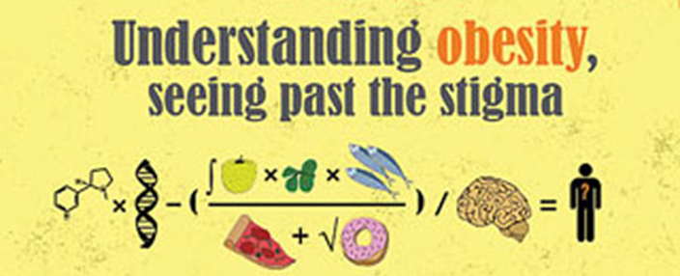
Factors Contributing to Obesity
Lifestyle
Poor diet, meal skipping, snacking, alcohol, inactivity
Psychosocial
Depression, anxiety, stress, binge eating, boredom, social events, income
Biomedical
Genetics, metabolism, medications, mobility issues, environmental toxins

Slide 18
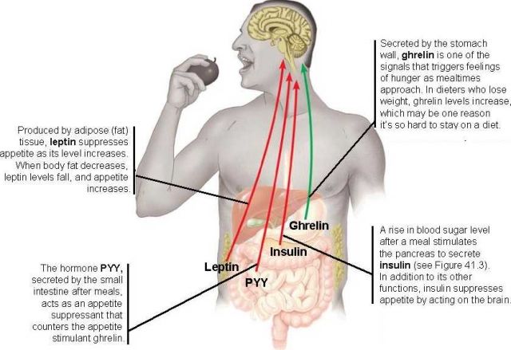
Hormones in Obesity

Slide 19
Nursing Care
-Safety of the client and staff
-Specialized equipment
-Consider private room
-Diagnostics
-Nutritional screening

Slide 20
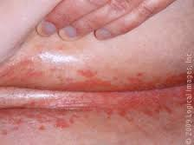
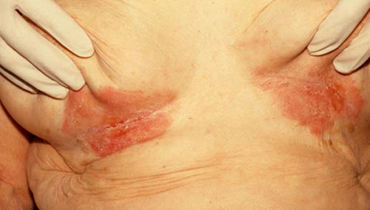
Skin
Numerous factors increase the risk of skin breakdown
↓Thermoregulation
Skin folds
Self-care deficits
Surgical Wounds
Decreased wound healing
Infections
Dehiscence
Interventions
Assess skin frequently
I If possible, do not use tape
Wound care specialist consult

Slide 21
Incontinence
Challenges:
-Increased pressure from abdomen can result in bladder and/or bowel incontinence
-Difficult to cleanse
-Self-care deficits
Interventions:
-Timely response to patient requests
-Routine toileting
- Frequent checking for moisture and changing as required

Slide 22
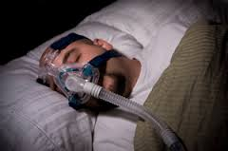
Respiratory
Obesity can be connected with:
  Obesity-related atelectasis
  Obesity Hypoventilation Syndrome (OHS)
  Obstructive Sleep Apnea (OSA)
Can also experience:
  Reduced chest wall compliance
  Increased work of breathing
  Decreased total lung capacity

Slide 23

Pharmokinetics
Minimal data for most medications
Treatment based on clinical outcomes
Nursing considerations:
Report effectiveness
Inform of body weight to other HCP’s
Needle length for injections

Slide 24

Case Study
Mrs. Stella Roman is a 60-year-old Caucasian woman
Subjective Data:
Reports gradual weight gain during past 40 years
Spends most of her free time watching television
Reports health problems related to type 2 diabetes mellitus, shortness of breath, hypertension, chest pressure, and osteoarthritis
Underwent knee replacement surgery at age 56 for osteoarthritis

Slide 25
Case Study
Objective Data
Physical Examination
Height: 162.5 cm (5'4”); weight: 95 kg (210 lb)
Has obese, non-tender, soft abdomen
Blood pressure: 160/100 mm Hg
Laboratory Results
Fasting blood glucose level: 13.9 mmol/L
Total cholesterol level: 5.3 mmol/L
Triglyceride level: 3.36 mmol/L
HDL cholesterol level: 0.8 mmol/L

Slide 26
Case Study
Discussion Questions
What are Mrs. Roman's risk factors for obesity?
  Inactivity
  Diabetes
  Osteoarthritis
  High cholesterol

Slide 27
Case Study
Discussion Questions
What is her estimated BMI?
  BMI is a person’s weight divided by the square of his or her height
  36kg/m²

Slide 28
Case Study
Discussion Questions
Of the possible complications of obesity, which ones does Mrs. Roman have? Why did she develop them?
  Hypertension
  Dyspnea
  Increased triglycerides, decreased HDLs
  Hyperinsulinemia/insulin resistance
  Osteoarthritis
Notes:
HTN: (increased circulating blood volume, abnormal vasoconstriction, decreased vascular relaxation, increased cardiac output)
Dyspnea:(reduced chest wall compliance, increased work of breathing, decreased total lung capacity, decreased functional residual capacity)
Increased triglycerides: Obesity
Hyperinsulinemia: Obesity
Osteoarthritis: (increased trauma to weigh bearing joints)

Slide 29
Case Study
Discussion Questions
Priority Decision: How would the nurse assist Mrs. Roman in designing a successful program for weight loss and weight management?
Successful weight loss (short term energy deficit; 1-2lbs/wk)
Successful weight control (long term behaviour changes)
Dietary intake (food journal)
Physical activity (30-60mins/day)
Notes:
Consider behaviour modification and drug therapy

Slide 30
Case Study
Discussion Questions
Priority Decision: On the basis of the assessment data presented, what are the priority nursing diagnoses? Are there any collaborative problems?
  Ineffective breathing pattern
  Sedentary lifestyle
  Imbalanced nutrition: more than body requirements
  Collaborative problems:
  Hypertension
  Osteoarthritis
  Diabetes mellitus
  Hypercholesterolemia

Slide 31
References
Bray, G.A., & Perreault, L. (2017). Obesity in adults: Overview of management. In F. Pi-Sunyear & T. Lipman (Eds.), UptoDate. Waltham, Mass: UptoDate. Retrieved from www.uptodate.com.
Centre for Disease Control and Prevention. (2016). Defining adult overweigth and obesity. Retrieved from https://www.cdc.gov/obesity/adult/defining.html
Heart and Stroke Foundation. (2017). Healthy weight and waist. Retrieved from http://www.heartandstroke.ca/get-healthy/healthy-weight/healthy-weight-and-waist
Lewis, S. M., Dirksen, S.R., Heitkemper, M. M., Bucher, L. & Camera, I.M. (eds.). (2014). Medical-surgical nursing in Canada: Assessment and management of clinical problems (3rd Ed.). Toronto, ON: Elsevier.
World Health Organiztion. (2010). WHO growth standards are recommended for use in the U.S. for infants and children 0-2 years of age. Retrieved from https://www.cdc.gov/growthcharts/who_charts.htm.

