Slide 1
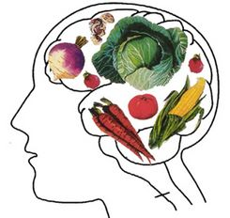
Nursing Care of the Client with Malnutrition: Week 3
Candace Walker - Winter 2019
Revised from K. McLaughlin

Slide 2
Concepts
Transition and change
Accountability
Collaboration

Slide 3
Learning Outcomes
Identify the related concepts of transition and change, collaboration, and accountability in relation to malnutrition
Understand the nursing care required to care for a malnourished client

Slide 4
Definition
“Malnutrition is a deficit, excess, or imbalance of the essential components of a balanced diet” (Soeters & Schols, 2009)
Can refer to alterations in:
Macronutrients (ie. carbs, proteins, fats)
Micronutrients (electrolytes, vitamins, minerals)
May also be described as under or over nutrition

Slide 5
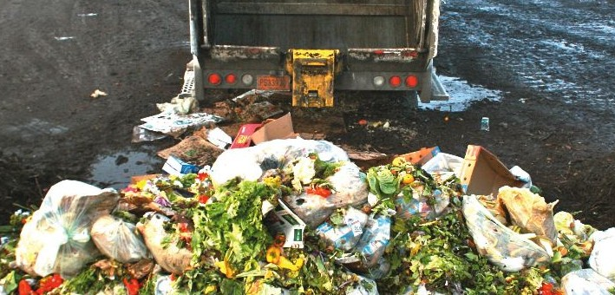
Undernutrition
Developing countries:
Inadequate food sources
Socioeconomics
Canada:
Key SDOH
Lone-parent families
Social assistance
Indigenous people living off reserve
Hospital and LTC
37-55%

Slide 7
Protein-Calorie Malnutrition (PCM)
Most common
Primary, Secondary, and Combined (most ill, malnourished patients)
Primary:
Poor eating habits
Diet low in protein, vitamins, and minerals

Slide 8
Protein-Calorie Malnutrition (PCM)
Secondary:
AKA “disease-related malnutrition”
Alteration or defect in:
Ingestion
Digestion
Absorption
Metabolism
Causes:
GI obstruction
Surgical procedure
Cancer
Malabsorption Syndromes
Drugs
Infectious diseases

Slide 9
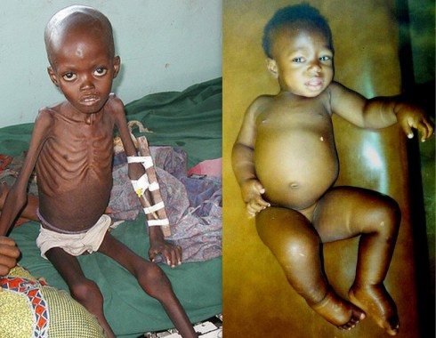

Slide 10
Etiology
Development of malnutrition
Socioeconomic factors
Physical illness
Incomplete diets
Food-drug interactions
Psychological illness

Slide 11
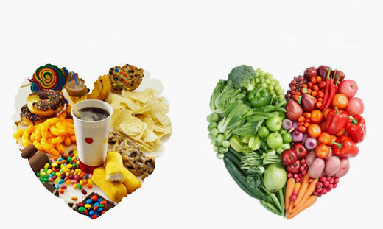
Etiology - socioeconomics
Socioeconomics
Food Security: “Physical and economic access to sufficient, safe, and nutritious food that meets food preferences and dietary needs for an active and healthy life” (Cook et al., 2008)
Food insecurity
Quality
Quantity
Nutritional value
Underweight and obesity
Safety nets
“Heat or eat”
Seniors – meds vs. food

Slide 13
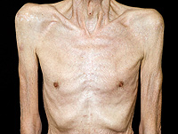
Etiology – physical illness
Physical Illnesses
Increased nutritional needs
Undernutrition affects health, poor health affects nutrition
interference of food consumption and metabolism
Anorexia is “a loss of normal appetite and may occur as a result of physical or mental illness”
Cachexia refers to “a wasting syndrome that causes weakness and loss of weight, fat, and muscle”
Malabsorption Syndrome is “the impaired absorption of nutrients from the GI tract”

Slide 14
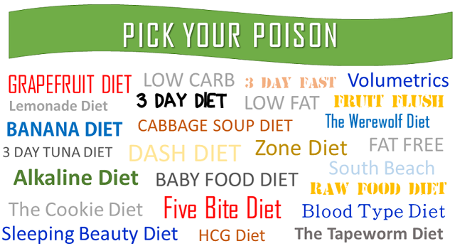
Etiology-incomplete diets
Incomplete Diets
Vitamin deficiencies
Canada’s food guide
ETOH/drug use, chronically ill, poor diets
Fad diets, “poorly planned” vegetarians
Vitamin imbalances affect NEURO
Children – CNS
Adults - PNS

Slide 15
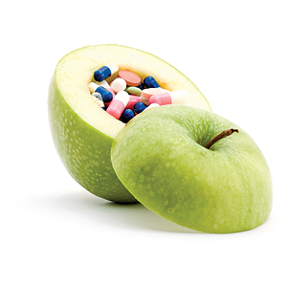
Etiology – food-drug interactions
Food-Drug Interactions
Incompatibilities
Altered drug effectiveness
Impaired nutritional status
OTC/herbs/dietary supplements
Corticosteroids, chemotherapy

Slide 16
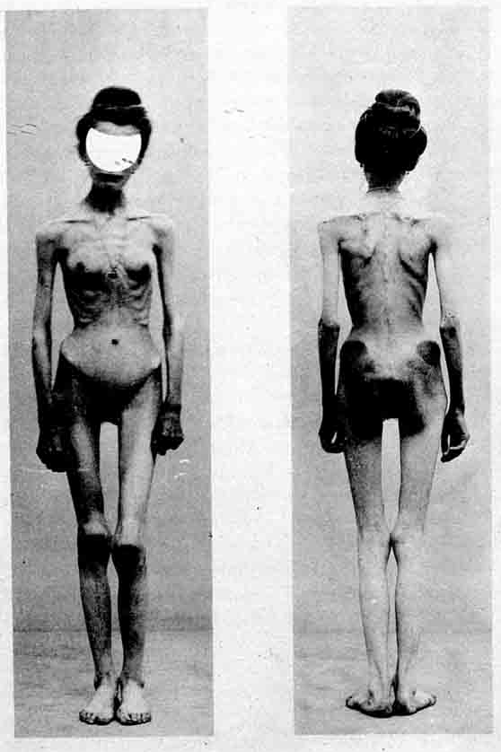
Etiology-psychological illness
Eating Disorders
Associated with mood, personality, and anxiety disorders
Society and body image
Mortality rate
30% male
Anorexia Nervosa
Bulimia Nervosa

Slide 17
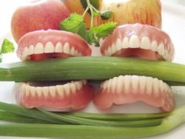
Malnutrition in the elderly
Increased risk factors
Age
Decreased taste buds
Dental problems
Food intolerance
Physical disability
Prescribed diets
Medications
Loneliness/isolation
Socioeconomic factors

Slide 18
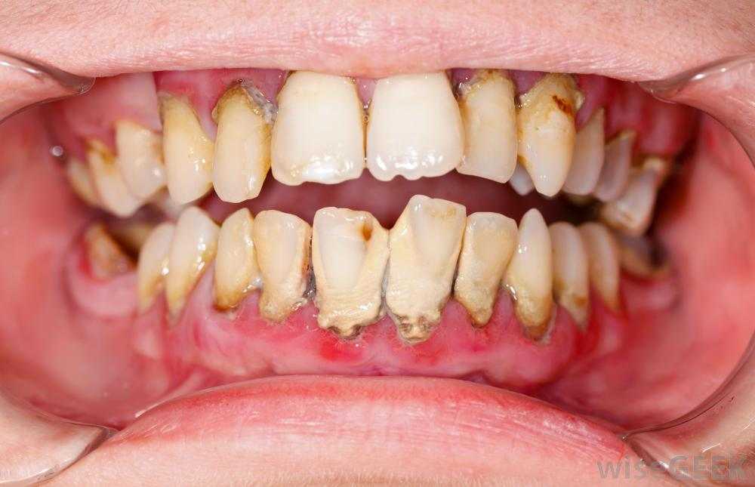
Clinical Manifestations
Skin:
Dry, scaly
Brittle nails
Rashes
Hair loss
Mouth:
Crusting and ulceration
Changes in tongue
Tooth decay
Muscles:
Decreased mass
Weakness
CNS:
Cognition – confusion, irritability, lethargy

Slide 19
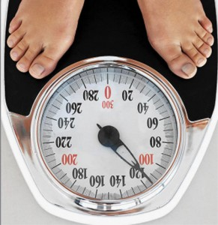
Assessment
Height
Weight
Diet history
Medical history
Routine lab data
Albumin/Prealbumin
Transferrin
CRP
Electrolytes
RBC and Hgb
Lymphocyte count
LFTs

Slide 20
Assessment
Tools:
Malnutrition Screening Tool (MST)
24 hour Recall
Food Frequency Questionnaire
Food Diary
Direct Observation

Slide 21
Diagnosis
Imbalanced nutrition
Self-care deficit (feeding)
Constipation or diarrhea related to poor eating patterns, immobility, or medication effects
Deficient fluid volume related to factors affecting access to or absorption of fluids
Notes:
Imbalanced nutrition
less than body requirements related to decreased access to or ingestion, digestion, or absorption of food or to anorexia
Self care deficit
related to decreased strength and endurance, fatigue, and apathy

Slide 22
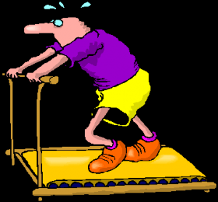
Diagnosis
Risk for impaired skin integrity related to poor nutritional state
Nonadherence
Activity intolerance
http://phoenixrising.me/wp-content/uploads/deconditioned-runner-300x278.png
Notes:
Non adherence:
related to alteration in perception, lack of motivation, or incompatibility of regimen with lifestyle or resources
Activity intolerance:
related to weakness, fatigue, and inadequate caloric intake or iron stores

Slide 23
Planning
Achieve weight gain
Consume a specified number of calories per day (with a diet individualized to the patient)
Have no adverse consequences related to malnutrition or nutrition therapies

Slide 24
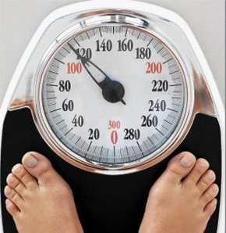
Implementation
Health Promotion
Ambulatory and Home Care
Acute Intervention
Notes:
Health promotor:
Caregiver
Teacher
Promoter of health
Resource person
Home care
Consider past eating habits, religious or ethnic preferences, age,
income, community or other resources, state of health
Acute intervention
Assess nutritional status and physical problems
High calorie/protein intake
Fluid and nutrients
Daily weights and calorie counts
Food preferences and food from family

Slide 25
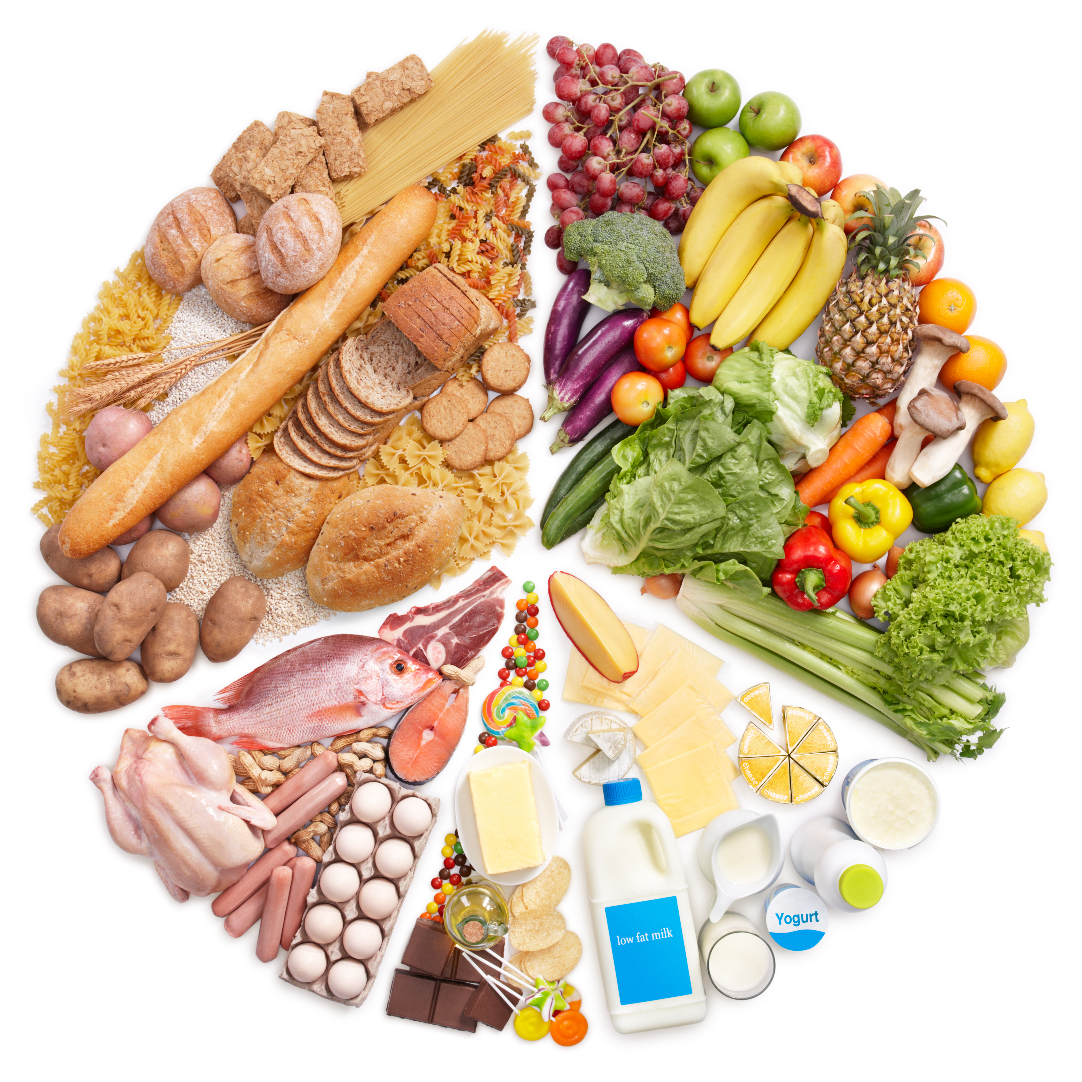
Evaluation
The patient will achieve and maintain optimal
body weight
The patient will consume a well-balanced diet
The patient will experience no adverse outcomes
related to malnutrition

Slide 26
Concepts – article discussion
What is the appropriateness of this research for nursing care?
2. Identify the implications for nursing practice:
How would our nursing assessment need to be altered?
What concepts are highlighted in regards to provision of nursing care?
What nursing diagnosis would be important here?

Slide 27
Case study – activity
Carrie Green, a 32-year old mother, is considering switching her entire family to a vegan diet as she believes it will make her 3-year old twin daughters healthier.
1. What nutritional concerns should you watch for?
2. How would you assess the family’s nutritional needs and monitor for such concerns?
3. What advice would you offer to Carrie to enhance her family's health while following a vegan diet?
4. Plan one day of meals for this family, indicating food servings for the twins that would meet heir protein needs and respect the vegan food diet.

