Slide 1
Nursing care of the client with a CVA (long term management)
NURS 2830 – week 2

Slide 2
Concepts
Loss
Grief
Loneliness
Isolation
Collaboration
Providing a safe environment

Slide 3
Learning Outcomes
Identify the related concepts of loss, isolation, and grief with CVA management
Understand the long term management for a client with CVA
Understand the rehabilitation nursing management for a client with CVA
Understand The psychosocial impact of a CVA on the client and family

Slide 4
Article / In-prep Discussion
Why is it important for nurses to understand the psychosocial impact stroke can have on individuals? Please provide an example with client confidentiality in mind.
What are the Stages of Change?
How are the feelings and thoughts expressed by the clients within the study similar to the Stages of Change?
How can a registered nurse use the Stages of Change in practice with clients who have experienced a stroke?

Slide 5
Stroke recovery
https://www.youtube.com/watch?v=YgpYG5_97nE

Slide 6
Stroke Admission
Primary Assessment
Long term Assessment
Goals
Maintain stable or improved LOC
Max physical function
Max self care
Maintain body function
Max communication abilities
Adequate nutrition
Avoid complications
Personal coping

Slide 7
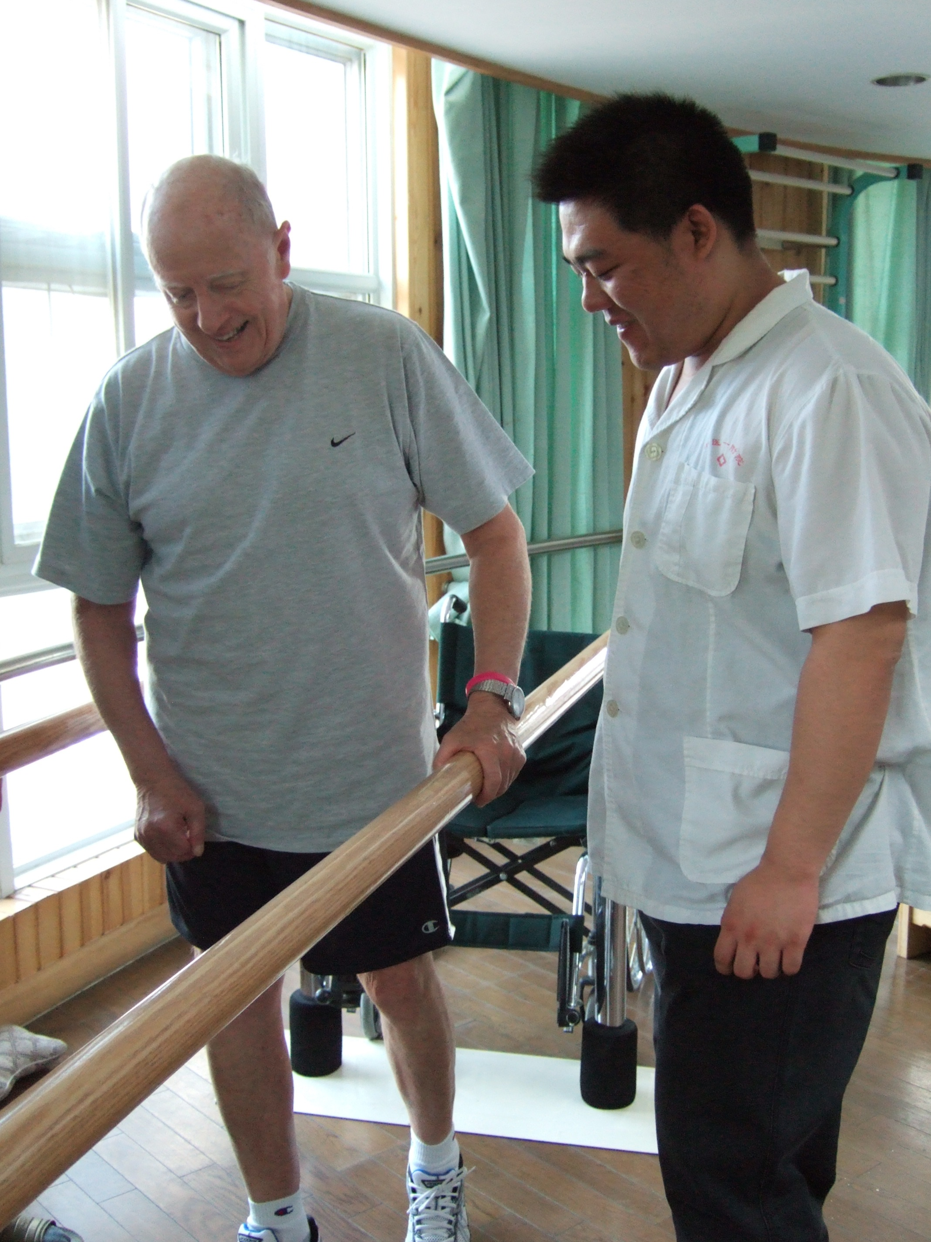
Stroke Recovery - Rehabilitation
Assess level of ADL’s
Education
Total care
Medications
Nutrition
Mobility
Exercises
Hygiene
Toileting

Slide 8
Stroke recovery - coping
Losses
Sensory
Intellectual
Communicative
Functional
Role behavior
Emotional
Social
Vocational
Sexual function

Slide 9
Stroke management: Activity

Slide 10
Class Activity: Organize into groups listed below
Clinical Group | Area of Focus / System
MAT | Neurological / cardiovascular
4N / 3W | Respiratory / Gastrointestinal
6N | Genitourinary / Integument
6S | Musculoskeletal / psychosocial
7N | Communication

Slide 11
Class Presentation
Within your groups, address the area of focus or system assigned to you
Brainstorm all the potential health risks associated with that system and long term CVA recovery
Example: GI: Dysphagia
3) For each potential health issue, indicate a nursing intervention to address the issue
Example: For dysphagia, a nursing intervention would be mouth care TID
4) Record this information on the paper provided and present to the class

Slide 12
Class Activity: Group Discussion
Within your groups, choose one system and one potential health issue that would be appropriate to teach about to your client and family
Your instructor will assign the group a client who has experienced a CVA with individualized deficits
Create a teaching plan with at least one resource to accommodate for the client’s deficits regarding the topic you have chosen
Provide an evaluation plan to ensure the client and family have understood the content of your teaching plan
Submit work to instructor; provide names of group members at the top of the page

