Slide 1

IDF DIABETES ATLAS
Eighth edition 2017

Slide 2
10 million more adults with diabetes than 2015
34 million more adults are at risk of developing diabetes than 2015
8 million more adults above 65 years old with diabetes than 2015
Over a million children and adolescents have type 1 diabetes
19 million more adults with diabetes are undiagnosed than 2015
1 in 6 live births is affected by hyperglycaemia in pregnancy
USD 54 billion more is spent on diabetes than 2015
Highlights:

Slide 3
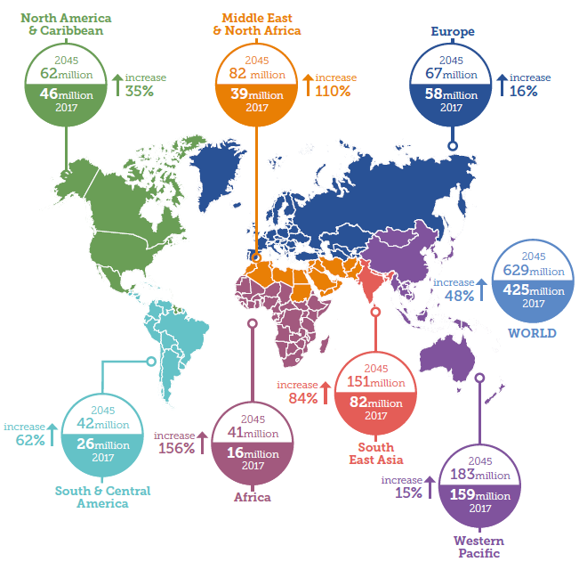
Diabetes: A global emergency
Number of people with diabetes worldwide and per region in 2017 and 2045 (20-79 years)

Slide 4
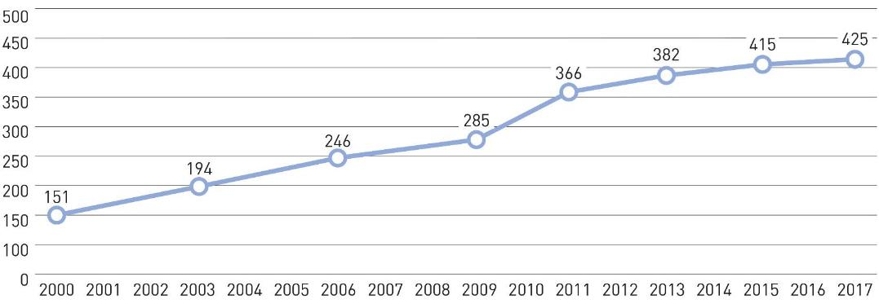
Diabetes around the world
Total number of adults with diabetes (20-79 years)

Slide 5
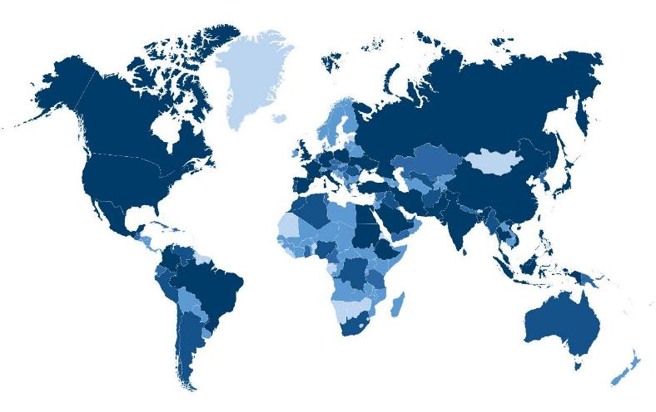
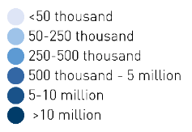
Diabetes around the world
Estimated total number of adults (20-79 years) living with diabetes, 2017

Slide 6
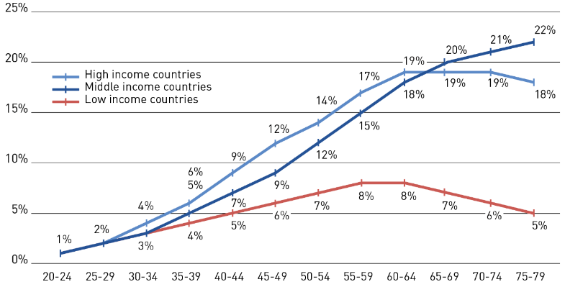
“4 out of 5 people with diabetes live in
low- and middle-income countries”
Diabetes around the world
Prevalence (%) estimates of diabetes (20-79 years) by income group and age

Slide 7
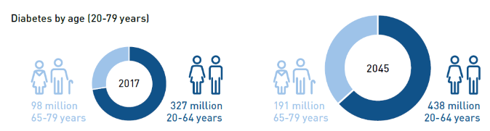
Diabetes around the world

Slide 8
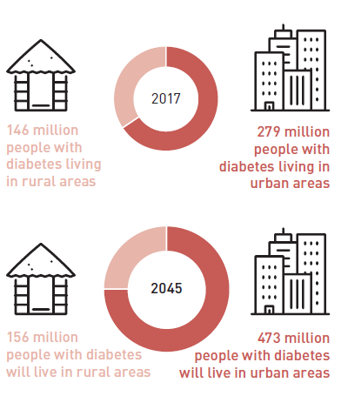
“Two-thirds of people with diabetes live in
urban areas
and number will increase to
three fourths by 2045”
Diabetes around the world
Rural-urban division among people with diabetes

Slide 9
Diabetes around the world

Slide 10
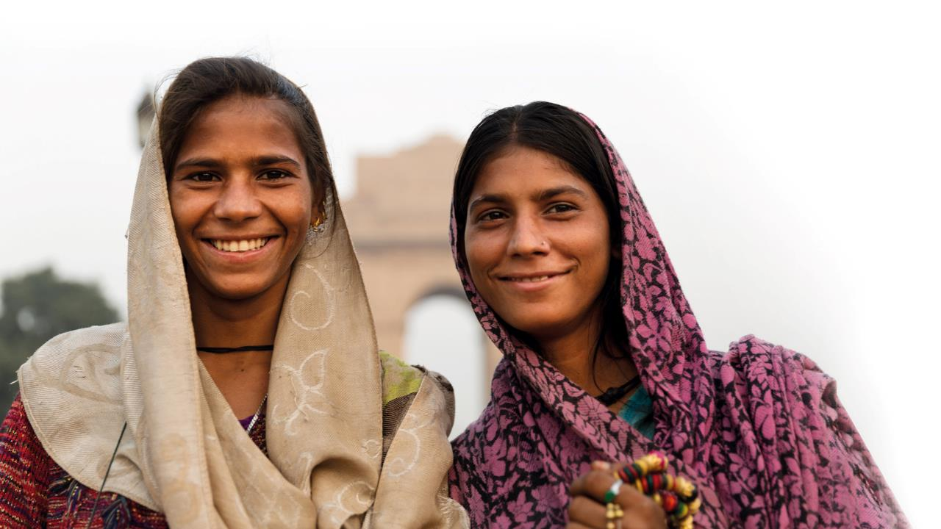
Diabetes occurs when there are raised levels of glucose in the blood because the body cannot produce any or enough of the hormone insulin or use insulin effectively

Slide 11
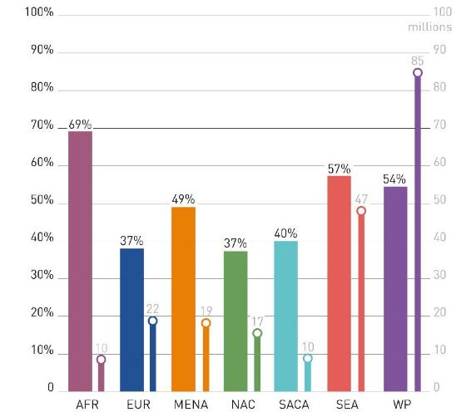
“One in two adults with diabetes are undiagnosed
(over 212 million people)”
Undiagnosed Diabetes
Undiagnosed percentage and undiagnosed cases of diabetes (20-79 years) per region

Slide 12

There are cost-effective and evidence-based solutions to reverse the
global type 2 diabetes epidemic

Slide 13
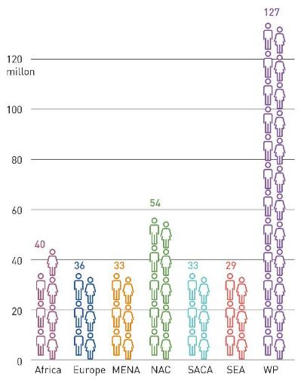
“One in 14 adults
(20-79 years) has
impaired glucose tolerance
(352 million people)”
Impaired Glucose Tolerance
Number of adults (20-79 years) with IGT per IDF region, 2017

Slide 14
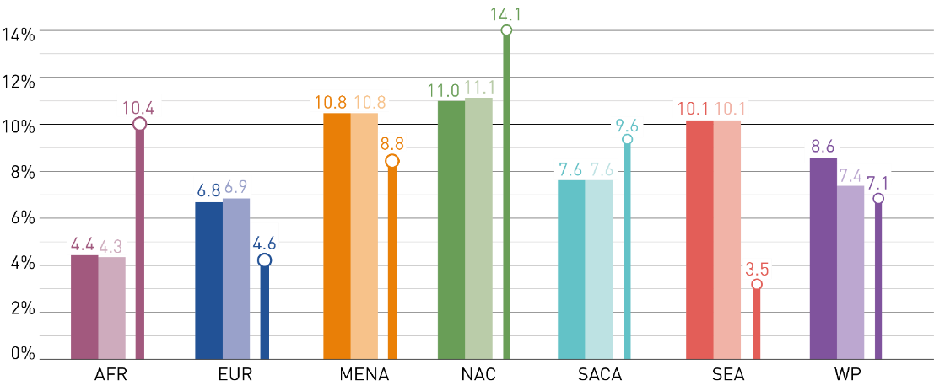
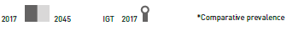
Impaired Glucose Tolerance
Prevalence* of diabetes and IGT (20-79 years) by IDF region, 2017 and 2045

Slide 15

“Patient self-management is an important
part of successfully preventing or delaying diabetes
complications”

Slide 16
“1 in 6 live births is affected by hyperglycaemia in pregnancy”
Hyperglycaemia in pregnancy
Hyperglycemia in pregnancy in women aged 20-49 years by IDF region, 2017

Slide 17

Governments and other stakeholders prioritise affordable and equitable access to insulin an essential life-saving medicine for people with diabetes

Slide 18
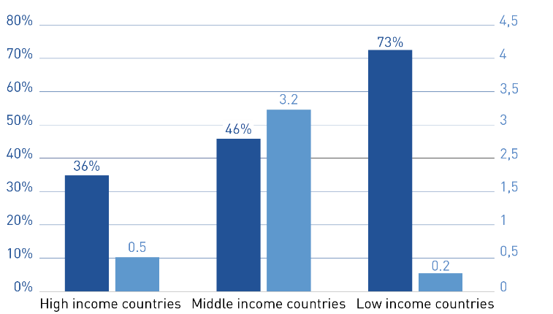
“Half of the 4 million people who die
from diabetes are under the age of 60”
Mortality
Deaths attributable to diabetes by age (20-79 years)

Slide 19
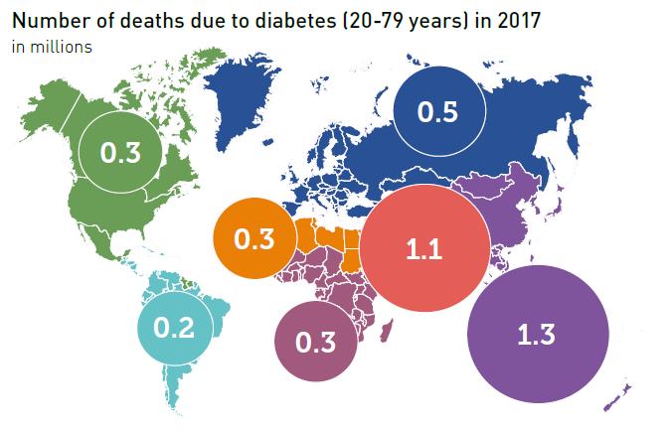
Mortality

Slide 20
IDF education and prevention initiatives aim to support the development of health professionals so they are equipped to deliver high-quality, diabetes care and promote specific models of care to achieve optimal management of all types of diabetes

Slide 21
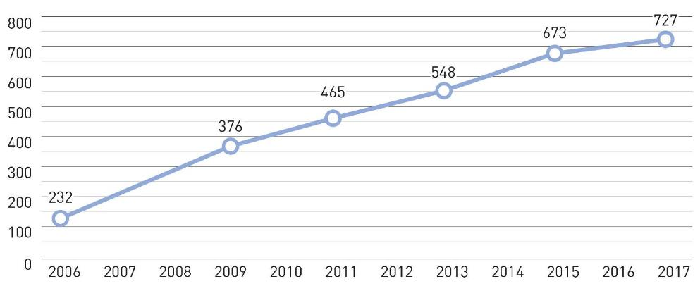
“USD 54 billion more is spent on diabetes than 2015”
Healthcare Expenditure
Total healthcare expenditure by people with diabetes (20-79 years)
*Billion USD

Slide 22
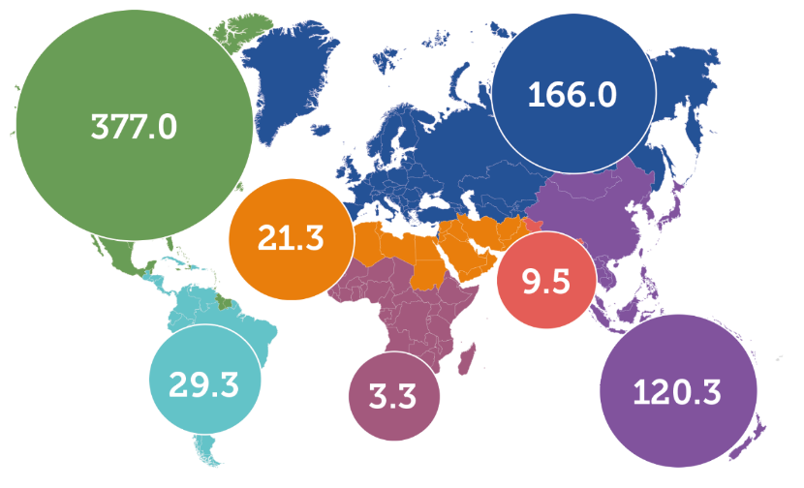
Big differences in healthcare spent for diabetes across IDF regions
Healthcare Expenditure
Diabetes-related healthcare expenditure in adults (20-79 years) in 2017 per IDF region

Slide 23
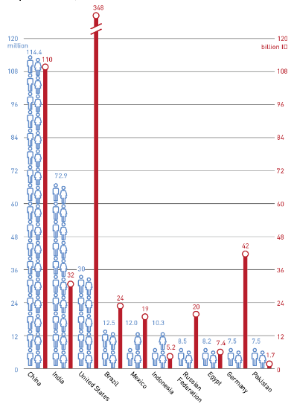
The top 10 countries for number of adults with diabetes account for the 60% of people with diabetes and 69% of global healthcare expenditure on diabetes
Healthcare Expenditure
Top 10 countries for number of adults with diabetes (20-79 years) and their healthcare expenditure, 2017

Slide 24
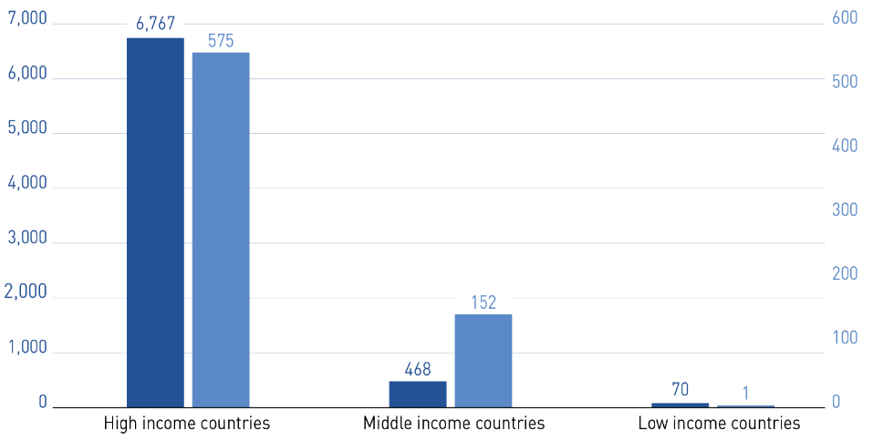
Among high income countries,
79% of global healthcare expenditure on diabetes was spent, but only 36% of deaths below 60 years occurred
Healthcare Expenditure
Expenditure and deaths below 60 years (%) due to diabetes by income group

Slide 25

“People with diabetes, can live healthy and fulfilling lives
with the provision of an uninterrupted supply of insulin and blood glucose testing equipment, when combined with a healthy lifestyle”

Slide 26
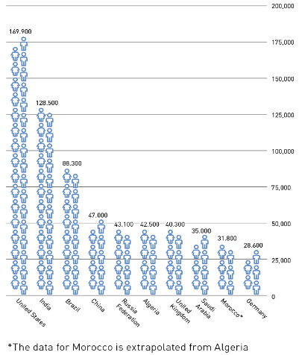
“35% of the children and adolescents with T1D
(<20years) come from the top 3 countries”
Diabetes in Children and Adolescents
Top 10 countries for number of children and adolescents with type 1 diabetes (<20 years), 2017

Slide 27
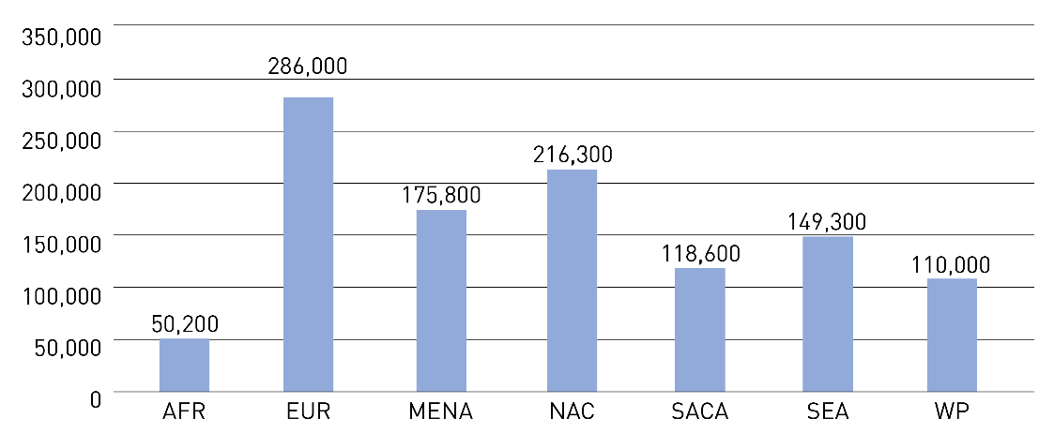
Diabetes in Children and Adolescents
Estimated number of children and adolescents (<20years) with type 1 diabetes by IDF region, 2017

Slide 28
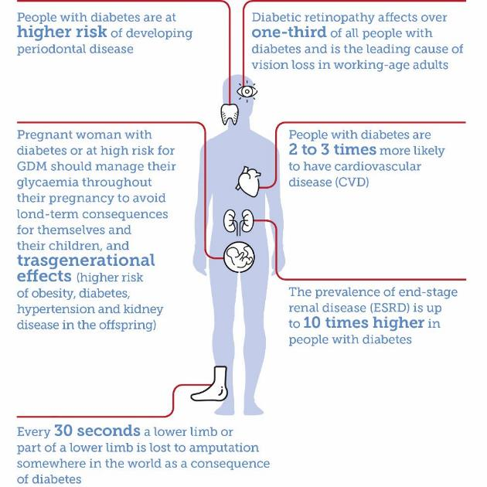
Diabetes Complications

Slide 29




Promote high-quality research on diabetes
epidemiology.
Implement National Plans and Strategies to
reduce diabetes burden.
Prioritization of diabetes care and control.
Recommendations
Extend health promotion to reduce diabetes
and its complications.

