Slide 1
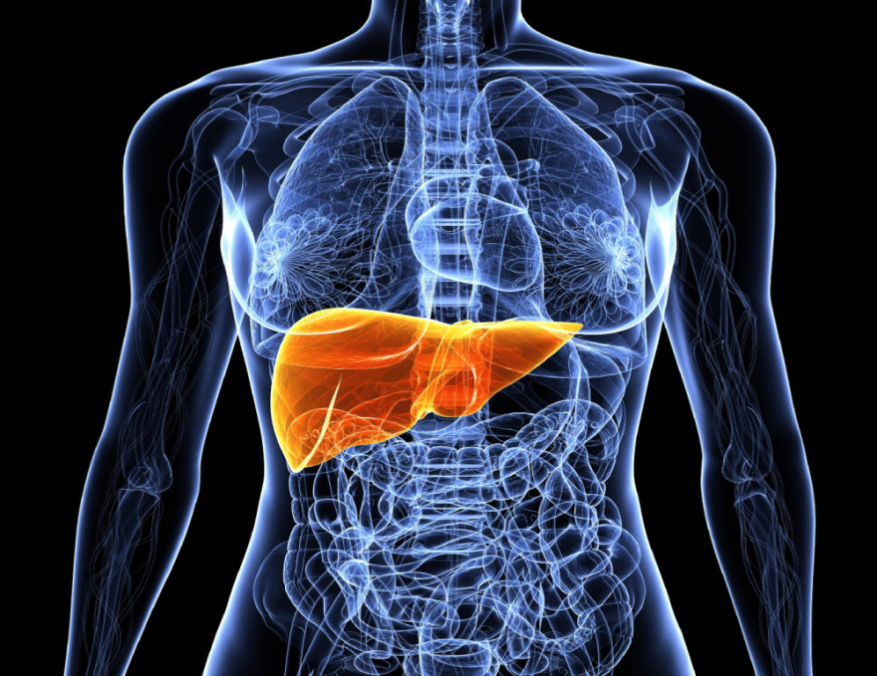
Care of the Client with Liver Cirrhosis – Week 12
NURS 2830 – Winter 2018
C. Walker
Revised by P. MacNeill
Revised from K. McLaughlin 2016

Slide 2
Concepts
Comfort
Epidemiology
Healing
Spirituality
Hope

Slide 3
Learning Outcomes:
Understand cirrhosis as a disorder of the liver
Understand the nursing care of the client with cirrhosis including cause, nursing assessment, labs, and nursing interventions

Slide 4
Cirrhosis of the Liver
Chronic progressive disease of the liver characterized by extensive degeneration and destruction of the liver cells
Disorganized regeneration of liver cells
Fibrous connective tissue …. obstruct bile and blood flow
Abnormal blood vessels and bile ducts
Lobular structure disorganized which impedes blood flow
Cell necrosis and eventual scar tissue

Slide 5
Cirrhosis of the Liver
Men twice as likely as women
Highest incidence:
40-60 years of age

Slide 6
Cirrhosis: Cause

Slide 7
Subjective Assessment – Cirrhosis

Slide 8
Subjective Data: Cirrhosis of the Liver
Often insidious development
Early symptoms:

Slide 9
Objective Data: Liver Cirrhosis
Late:
Jaundice
Skin lesions
Hematological problems
Endocrine disturbances
Peripheral neuropathy
Early:

Slide 10
Lab Values
AST
ALT
Alk phosphatase
Albumin
Bilirubin
Coagulation
Ammonia
CBC
Electrolytes
Diagnostics – liver ultrasound, biopsy

Slide 11
Liver Cirrhosis
Complications:
Portal hypertension
Ascites
Hepatic encephalopathy
Esophageal varices
Splenomegaly

Slide 12
Complications of Cirrhosis: Portal Hypertension
Impaired blood flow due to increased resistance and/degeneration of liver tissue
Sluggish blood flow pressure in portal circulation and systemic circulation
Esophageal varices – dilated veins at lower end of esophagus
Ascites – 3rd spacing in peritoneum

Slide 13
Complications of Cirrhosis: Hepatic Encephalopathy
Elevated serum ammonia levels
Symptoms range from mild to severe
Classic sign – asterixis
Treatment:
Correct precipitating factors

