Slide 1
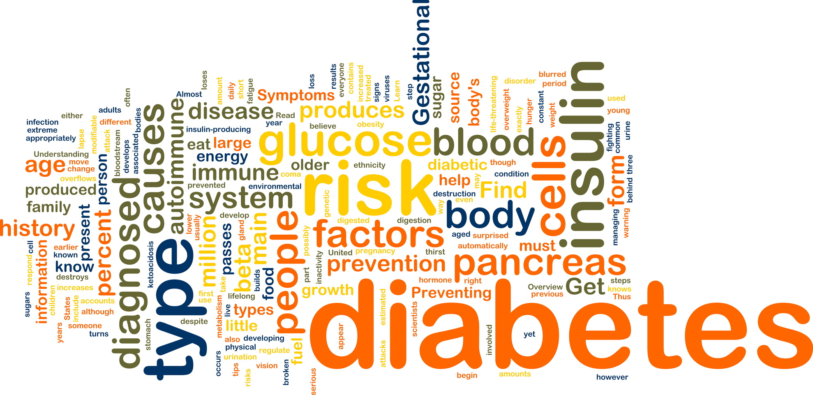
Care of the Client with Diabetes- Week 7
Candace Walker Winter 2019
NURS 2830

Slide 2
Concepts
Teaching and Learning
Healing Initiatives
Illness
Primary Health Care
Suffering
Community
Family
Environment

Slide 3
Ends-in-View:
The learner will be able to:
Understand the differences between types I and type II diabetes including etiology and risk factors
Understand assessment and diagnostic studies
Define and understand the implications of gestational diabetes
Describe the management of diabetes including healing initiatives
Understand common acute and long-term complications of diabetes
Identify teaching and learning interventions for health promotion

Slide 4
Diabetes Mellitus
Diabetes mellitus is a chronic multisystem disorder of glucose metabolism related to absent or insufficient insulin supplies and/or poor utilization of the insulin that is available
What is a chronic illness?
http://www.indiatimes.com/health/healthyliving/diabetes-mellitus-what-is-type-1-diabetes-mellitus-239713.html

Slide 5
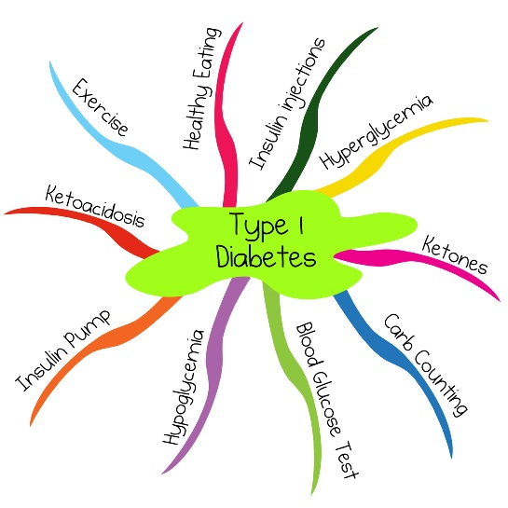
Type 1 Diabetes
Most often occurs in:
Results from progressive destruction of pancreatic β cells owing to an autoimmune process in susceptible individuals
http://www.articlesofhealthcare.com/80/types-of-diabetes-mellitus-1-2-gestational.html

Slide 6
Type 1 Diabetes

Slide 7
Type 1 Diabetes
Requires a supply of insulin from an outside source (exogenous insulin)
Without insulin, the patient will develop diabetic ketoacidosis (DKA), a life-threatening condition resulting in metabolic acidosis

Slide 8
Prediabetes
A condition where blood glucose levels are higher than normal but not high enough for a diagnosis of diabetes
Presents an increased risk for developing type 2 diabetes:
Long-term damage to the body (especially the heart and blood vessels) may already be occurring in patients with prediabetes

Slide 9
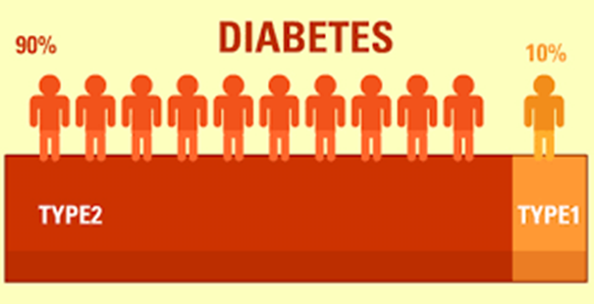
Type 2 Diabetes
The most prevalent type of diabetes, accounting for over 90% of patients with diabetes
Most important risk factors:
Obesity (specifically abdominal and visceral adiposity)
Metabolic syndrome (also known as insulin resistance syndrome) is characterized by:
http://www.changeyourmindbodyhealth.com/blog/tag/type-2-diabetes/

Slide 10
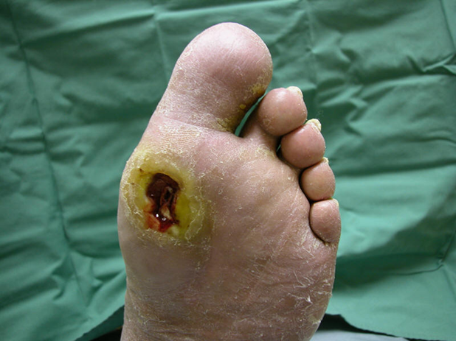
Type 2 Diabetes
Pancreas usually continues to produce some endogenous (self-made) insulin
Insulin that is produced is either insufficient for the needs of the body and/or is poorly used by the tissues
More common manifestations:

Slide 11
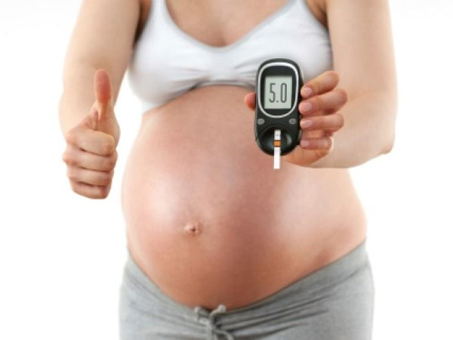
Gestational Diabetes
Develops during pregnancy
Is detected at 24 to 28 weeks of gestation
Most women will have normal glucose levels within 6 weeks postpartum
Risk for developing type 2 diabetes in 5 to 10 years is increased for mother

Slide 12
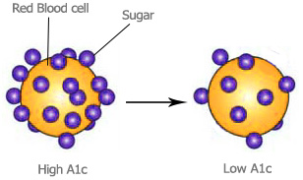
Diagnostic Studies
Based on one of four methods:

Slide 13
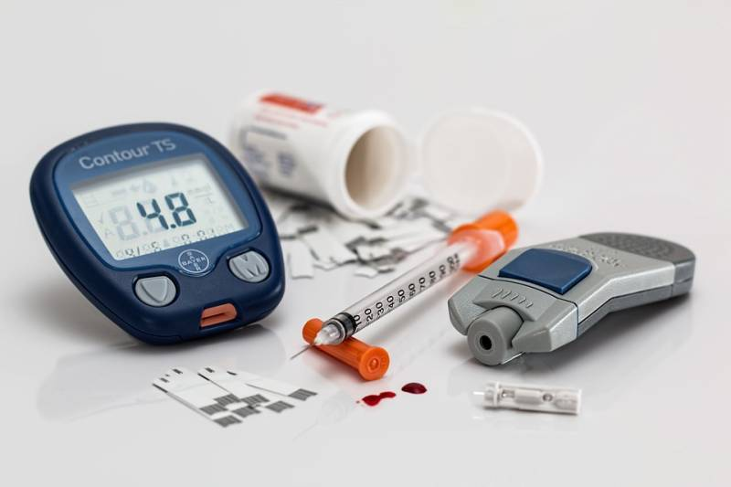
Nursing Assessment - Monitoring Blood Glucose
Self-monitoring of blood glucose (SMBG) is a cornerstone of diabetes management
Enables the patient to make self-management decisions regarding:
Frequency depends on:

Slide 14
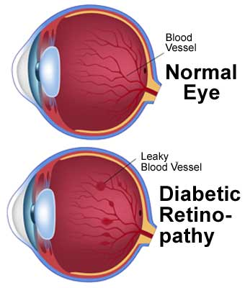
Nursing Assessment
Integument
Eyes
GI
Neurological
Cardiovascular
respiratory

Slide 15
Planning care for the Diabetic Client
Goals of diabetes management:

Slide 16
Nursing Management
Client goals:
Active participant in management
Few or no episodes of hyperglycemia/
hypoglycemia emergencies
Maintain blood glucose levels (close to normal)
Prevent common complications

Slide 17
Acute intervention
Management of Acute Hyperglycemia (DKA)
Management of Hypoglycemia

Slide 18
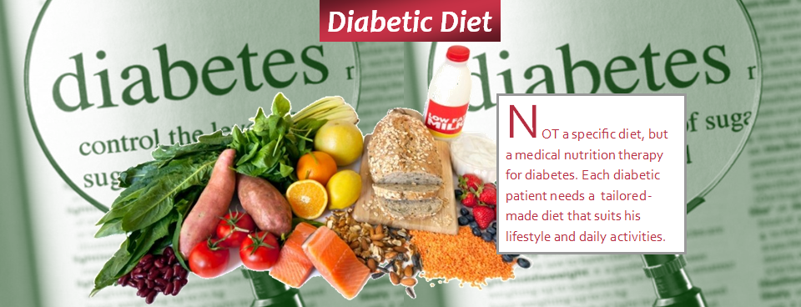
Health Promotion – Nutritional Therapy
Energy intake should be balanced against energy output, appreciating exercise and metabolism

Slide 19
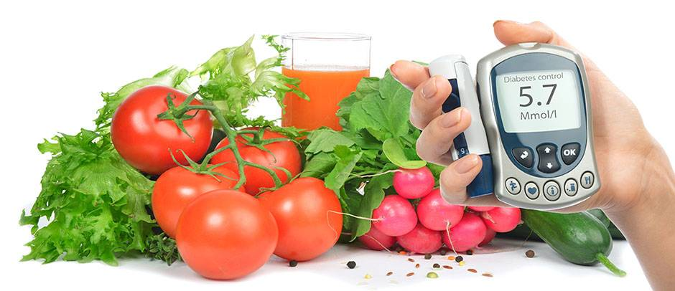
Nutritional Therapy
Overall goals:
Nutritional therapy can reduce A1C by an absolute 1 to 2% with the greatest impact at the initial stages of DM
Type 1 diabetes:
Consistency in timing and amount of food is important if using conventional, fixed insulin regimens
If using rapid-acting insulin can make adjustments in dosage before the meal based on current blood glucose level and carbohydrate content of the food
Type 2 diabetes:
Glucose, lipid, and blood pressure goals
Calorie and fat reduction

Slide 20
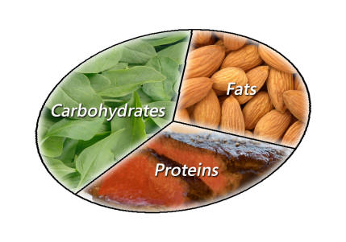
Nutritional Therapy
In a general diabetic meal plan:
Carbs and monounsaturated fat should comprise 45% - 60% of the total energy intake
Fats should comprise no more than 35% of the total calories
Protein should comprise 15% - 20% of the total energy
Fibre intake should consist of approximately 25 - 50 g/day from a variety of food sources, including soluble and cereal fibres

Slide 21
Nutritional Therapy
Alcohol:
Regular, consistent exercise is considered an essential part of diabetes and prediabetes management
Exercise increases insulin receptor sites in the tissue and can have a direct effect on lowering the blood glucose levels

Slide 22
Education
Blood glucose
Exercise
Nutrition
Medication
Other

Slide 23
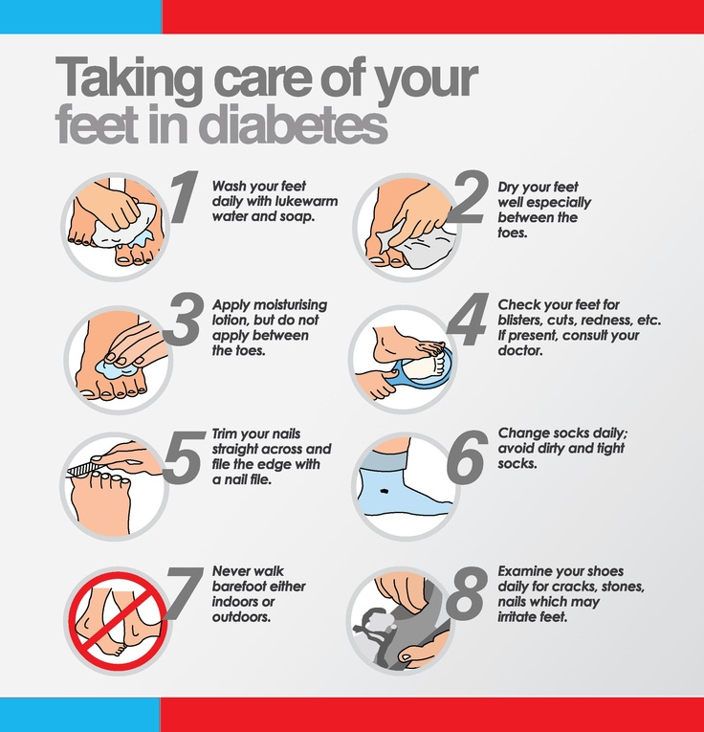
Evaluation – Nursing management
Prevention of long term complications

