Slide 1
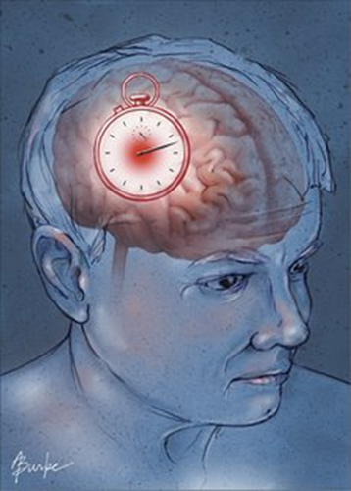
Nursing Care of the client with a Cerebral Vascular Accident (acute phase) NURS 2830 - Week 1
C. Walker Winter 2019 Adapted from K. McLaughlin 2016 and P. Nicol 2018

Slide 2
Concepts
Loss
Grief
Loneliness
Isolation
Collaboration
Providing a safe environment

Slide 3
Learning Outcomes
Identify the related concepts of loss, isolation, and grief with CVA management
The acute management for a client with CVA
The rehabilitation nursing management for a client with CVA
The psychosocial impact of a CVA on the client and family

Slide 4
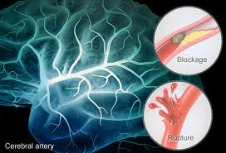
Cerebral vascular accident (CVA)
What is a CVA?
Typified by rapidly developing signs of focal or global disturbance of cerebral function lasting more than 24 hours or leading to death

Slide 5
Ischemic CVA’s
Thrombotic
Embolic
Caused by a blood clot that develops in the arteries in the brain
Caused by a blood clot or plaque debris elsewhere in the body which travels to the brain

Slide 6
Hemorrhagic CVAs
Intracerebral
Subarachnoid

Slide 7
Recurrent CVAs
The risk is greatest right after a CVA and decreases over time
Occur in about 25% of CVA patients within 5 years
3% of CVA patients have a second CVA within 30 days of their first CVA
1/3 of CVA patients have a second CVA within 2 years of their first CVA
The likelihood of severe disability and death increases with each recurrent CVA
(The John Hopkins University, n.d.)

Slide 8
Canadian Stroke facts
Annually, 62,000 Canadians are treated in hospital for stroke or TIAs
For every 1 stroke that is symptomatic, there are 9 that are “silent”
Stroke is a leading cause of adult disability in Canada
Annual cost of stroke is 3.6 billion dollars
(Heart and Stroke foundation, 2015)

Slide 9
Risk Factors
MODIFIABLE
NON-MODIFIABLE
Notes:
Nine in ten Canadians (24 million) have at least one risk factor for heart disease and stroke.

Slide 10
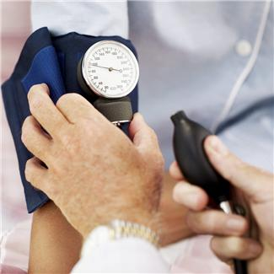
Hypertension
Most important and well-documented risk factor to prevent stroke occurrence
Promotes formation of Atherosclerosis plaques
Five million Canadians have diagnosed hypertension
Only 21% of Canadians know hypertension is a strong risk factor
Often inadequately diagnosed and undertreated, despite it is the most treatable risk factor

Slide 11
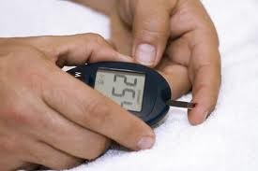
Diabetes
Major risk factor for ischemic CVA
If diabetic … double the risk of CVA

Slide 12
CVA: Clinical Manifestations
Sensory and Motor Functioning
- Will become impaired or lost
- Depends on location and extent in the brain
Due to the complexity of the brain, many body functions can be impacted due to CVA:

Slide 13
Acute Care management Goals

Slide 14
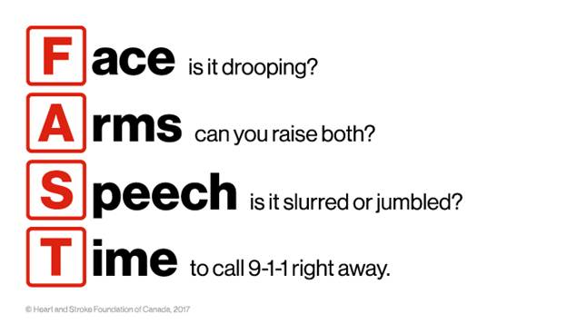
Nursing Assessment: Cincinnati Stroke Scale

Slide 15
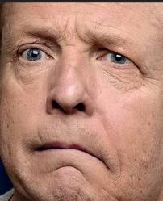
Facial droop
“Smile and show me
your teeth”
Notes:
http://www.CVAcenter.org/Trials/scales/cincinnati.html

Slide 16
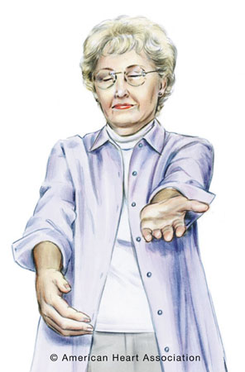
Arm drift
“Put your arms out in front of you, close your eyes and turn your palms up the ceiling”

Slide 17
Arm drift

Slide 18
Abnormal speech
Have client repeat a common phrase…
“You can’t teach an old dog new tricks” or the alphabet
Is their speech slurred or gargled?
Are they unable to speak?
Do they use the wrong words?

Slide 19
CVA: Nursing Intervention
What are the next steps?

Slide 20
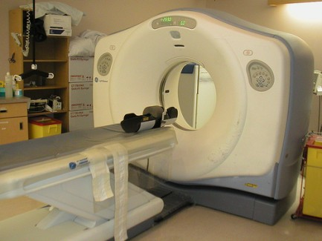
Diagnostics
CT Scan Head Non-Contrast
Blood glucose (capillary)
CBC, INR, PTT, Troponin,
Na, K, Cl, CO2, E4
Cr, BUN, Random glucose
12-lead ECG

Slide 21
CVA: Nursing Interventions
Initiate IV access and/or IV therapy as per physician’s order
Client NPO
Maintain oxygen levels greater than 92%
Consider higher level of care? Is client eligible for thrombolysis

Slide 22
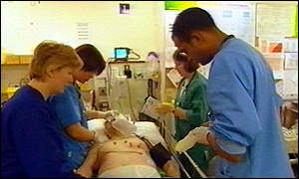
CVA: Monitoring And Assessment
Vital signs q1H
Neuro vital signs q4H
Toronto Bedside Swallowing Screen Test

Slide 23
Hot CVA Definition
Less than 3.5 hours since onset of symptoms
Significant deficit
- Aphasia, hemiparesis, ataxia, neglect
Family or client can provide medical history
No contraindication to Alteplase/tPA (clot busting drug)

Slide 24
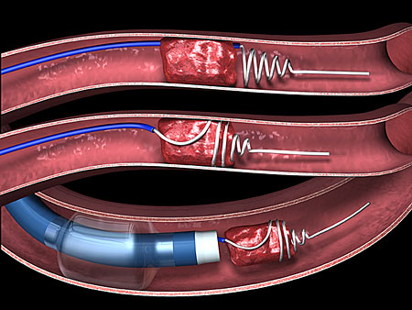
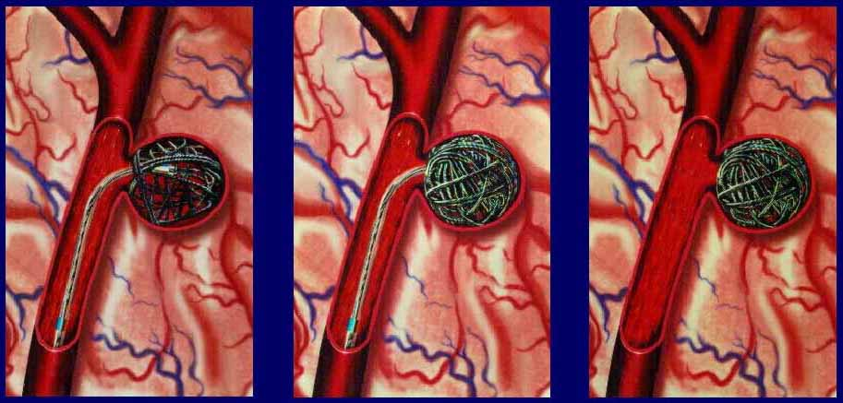
Surgical therapy
Ischemic
Surgery vs. Thrombolysis
1st Line Therapy
Hemorrhagic
Evacuation of aneurysm

Slide 25
Ischemic CVA: Thrombolysis
A diagnosis for ischemic stroke is required
Time frame is within 4.5 hours from symptom onset to fibrinolytic therapy
No contraindications from fibrinolytic are present

Slide 26
Alteplase: Absolute contraindications
Presence of cerebral hemorrhage or symptoms of subarachnoid bleed
BP > 185/110 despite 2 attempts to lower
Stroke/head injury within previous 3 months
Elevated INR or PTT
New oral anticoagulant use within 48 hours (Rivaroxaban, Apixaban, etc.)
Presence of active bleeding or trauma

Slide 27
Alteplase: relative contraindications
Pregnancy
Past Hx of MI
Witnessed seizure with residual neurological impairment
Major surgery/trauma within 14 days previous
GI or urinary tract hemorrhage within 21 days

Slide 28
Ischemic CVA: Ongoing Intervention
ASA therapy with 48 hours of CVA onset
VTE prophylaxis
Antiplatelet therapy prior to discharge
Lipid-lowering therapy (statin medication)
BP reduction
Education toward lifestyle changes
-Smoking cessation, physical activity, weight reduction

Slide 29
Blood Pressure Management: Acute Phase CVA
Ischemic CVA TREATED with Alteplase:
Target BP limit is 185/110 for 24 hours post treatment
Ischemic CVA NOT TREATED with Alteplase:
Target BP limit is 220/120
Hemorrhagic CVA:
Target BP limit is 180/100

Slide 30
References
Caplan, L.R. (2017). Overview of the evaluation of stroke. In S. Kasner & J. Dashe (Eds.), UptoDate. Waltham, Mass: UptoDate. Retrieved from www.uptodate.com
Fillho, J.O., & Mullen, M.T. (2017). Initial assessment and management of acute stroke. In S. Kasner & J. Dashe (Eds.), UptoDate. Waltham, Mass: UptoDate. Retrieved from www.uptodate.com
Government of Canada. (2016). Stroke in Canada. Retrieved from https://www.canada.ca/en/public-health/services/publications/diseases-conditions/stroke-in-canada.html
Heart and Stroke Foundation. (2015). Canadian stroke best practice recommendations. Retrieved from http://www.strokebestpractices.ca/wp-content/uploads/2010/10/CSBPR-2014_SoS-Recognition-Module-EN_Feb26-FINAL1.pdf
Interior Health Authority. (2013). Stroke/TIA ED diagnostics.
Interior Health Authority. (2015). Stroke/TIA admission.
Lewis, S. M., Dirksen, S.R., Heitkemper, M. M., Bucher, L. & Camera, I.M. (Eds.). (2014).
Medical-surgical nursing in Canada: Assessment and Management of Clinical Problems (3rd ed.). Toronto, ON: Elsevier.

